Slide 1
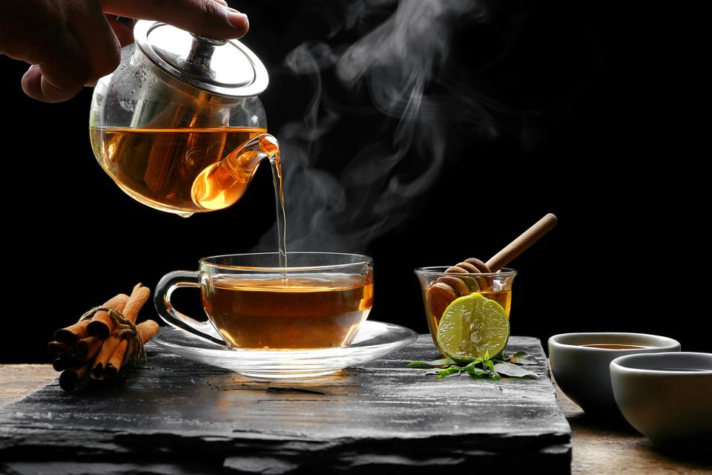
Tea Shop Business Plan
Presenter Name

Slide 2
Presentation Scope
Executive Summary
Introduction
Company Description
Market Analysis
Competition Analysis
Sales and Marketing Plan
Operating Plan
Management Plan
Financial Plan
Notes:
May require more than one slide

Slide 3
Executive Summary
Tea Time is a Tea Shop will provide a wide range of teas, tea accessories, pastries, and premium chocolates.
Over the last 15 years, the American Tea Market has significantly grown with tea sales increasing by up to 165%. The number of Tea rooms, tea shops and tea houses providing sit down services for people to enjoy tea have also increased by 15%. This highlights the growing demand for this services, Tea Time Tea Shop seek to tap into this market to provide quality and unique tea treats for customers to enjoy.
Tea Time Tea Shop’s mission is to provide high quality teas, tea accessories, chocolates and pastries to customers in a fun and relaxed atmosphere.
Our objectives is to produce reasonable net profit by the end of the third year of operation. The Tea Shop also seeks to achieve sales of $135400 in the first year and gradually increase sales to $189830 by the third year of operation.
Notes:
Tea time is a start up tea shop business that intends to provide a full wide variety of teas, chocolate, and pastries to customers. The American Tea market has been growing in the last 2 decades with a significant increase in tea consumption. Tea sales in the U.S have risen by 165% while business offering sit down services such as tea room and tea houses have increased by 15%. The rise of the tea market has been attributed to the changing fashion that fancies hot beverage drinks and the fact that many working Americans are accepting hot beverages as an affordable luxury. Tea Time Tea Shop’s mission is to provide high quality teas, tea accessories, chocolates and pastries to customers in a fun and relaxed atmosphere. The objective for the business is to increase profit as the business grows.

Slide 4
INTRODUCTION
Tea is one of the most widely consumed beverage in the world after water. It’s popularity has quickly grown in many countries of the world attracting many people who turning to drinking tea.
Tea shops offers people a social setting where people can enjoy tea.
In the United States, Tea ship are opening in small towns and large cities and the future looks promising as people’s preference and consumption of tea increase.
Statistics show that the overall tea industry in the U.S. is on an upward growth trend with the annual growth rate raising between 4 to 6 in the last 5 years.
This is an industry worth investing in, and this presentation provides a business plan for setting up and managing a Tea Shop.
Notes:
Tea is a popular beverage in the world only coming second to water. Tea’s popularity in the USA has quickly grown due to its linked health benefits and increasing use of tea for recreational purposes (Vieux et al., 2019). Tea shops provide a relaxing and fun environment where people socialize while enjoying tea. With the increasing demand for tea products in the United States, our tea shop focuses on venturing into this market and giving customers a new experience by providing them with premium teas, unique chocolate and pastries.

Slide 5
COMPANY DESCRIPTION
Tea Time Tea Shop is a start up business with the focus of providing customers a wide variety of tee including black tea, green tea, flavored tea, herbal tea and loose tea. The Tea Shop also will provide tea accessories, chocolates and pastries that will accompany tea orders.
Tea Time Tea Shop targets tea lovers and who have discretionary income. The targeted customers include;
  Business people
  Corporate employees
  Couples
  Tea lovers
Notes:
Tea Time Tea Shop is a start up business with the focus of providing customers a wide variety of tee including black tea, green tea, flavored tea, herbal tea and loose tea. The Tea Shop also will provide tea accessories, chocolates and pastries that will accompany tea orders. Tea Time Tea Shop targets tea lovers and who have discretionary income especially corporate employees and business people.

Slide 6
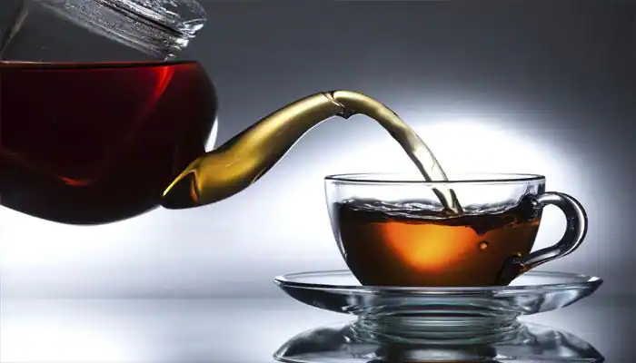
Products and Services
Tea Time Tea shop will specialize in providing customers with high quality tea that gives customers new experiences in a fun and relaxed environment.
  Variety of tea types
  Gift Baskets
  Pastries
  Tea accessories
  Chocolates
Notes:
The tea shop will provide customers to a wide variety of tea types including black teas, green teas, flavored teas, hot and iced teas. Tea Time Tea Shop will work with customers to provide pre-made gift baskets for any occasion. Freshly baked pastries will be offered to customers to complement the beverage.

Slide 7

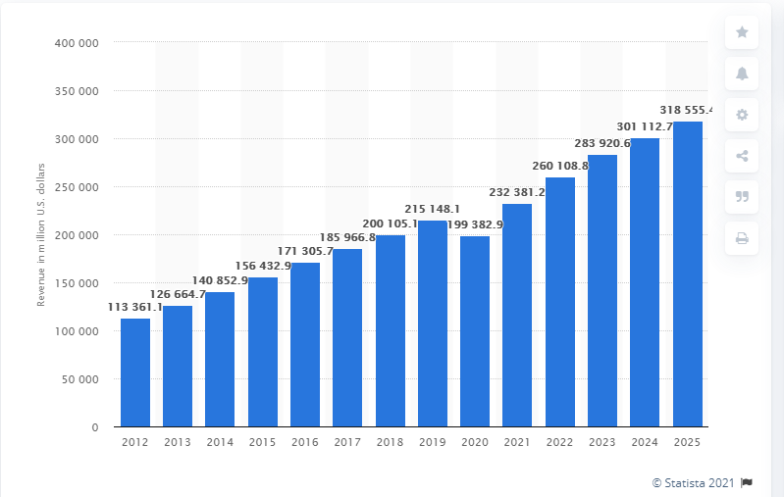
Market Analysis
In 2020 the global tea market was valued at approximately $200 million and expected to rise into the future. Tea’s popularity has grown world wide over the last couple of decades. A product that is thought to originate from Western Asia, it was used as a medicinal beverage, and gained popularity in Asian countries for recreational use. Tea’s popularity has significantly grown around the world with many people using it at any time.
Notes:
Over the last 2 decades, the global tea market has been on the rise. The tea market was approximated to be worth $200 million dollars in 2020 and projected to rise into the future. This is due to the growing trend of people turning to hot beverages due to fashion or as a result of a widely accepted idea that they are affordable luxuries. Additionally, exposure to western Asia practice and use of Tea for medicinal purpose has influenced tea use as making people are taking them for their health benefits (Vieux et al., 2019).

Slide 8
Market Analysis (Continuation)
Over the last 15 years, the American tea market has significantly grow with tea sales increasing by 165%. Tea shop, house and rooms offering sit in services for customers to enjoy tea have also significantly increased by 15% (Hajra, 2017).
The interest in tea has risen among most working Americans due to the marketing efforts made by giant beverage companies such as Seattle’s best and Starbucks. Additionally, the changing fashion has made hot beverages an acceptable idea.
An extensive literature evidence links tea with health benefits which has made consumers to turn towards as a natural, health beneficial and affordable luxury (Vieux et al., 2019).
Notes:
Tea shops in the United states have increased by 15% in the last 15 years partly because of the marketing efforts made by giant corporations such as Starbucks to popularize the hot beverages and the changing fashion trends. This is a market that is worth investing in as there is an increasing demand for tea and other hot beverages.

Slide 9
Market Analysis (Continuation)
Target Market Strategy
Tea Time Tea Shop will provide an relaxed and fun environment for upper and middle class customers to socialize while enjoying premium teas, unique chocolates and pastries.
Tea Time Tea Shop customers will be happy to pay for our premium tea, pastries, unique chocolates and high quality services.
Higher prices for some items such as unique chocolates can encourage sales as customers always to bust the best and high quality products.
Notes:
Tea Time Tea Shop will provide an relaxed and fun environment for upper and middle class customers to socialize while enjoying premium teas, unique chocolates and pastries. The tea shop will leverage on its ability to provide a conducive environment for people to enjoy tea and its high quality products and services. Tea Time Tea Shop customers will be happy to pay for our premium tea, pastries, unique chocolates and high quality services.

Slide 10
Competition Analysis
Strengths
The hot beverage shops, rooms and houses are common in urban areas. Major competition include multinational corporations such as Starbucks and Seattle Best. These corporations enjoy considerable success in providing hot beverages in the United states and other countries in the world. Starbucks has a strong brand that easily attract customers and it enjoys a dominant position in the hot beverage industry (Gupta, Nagpal, & Malik, 2018).
Starbucks enjoys considerable success with a strong financial performance therefore, can price its products at middle and high tier range to attract customers.
The company has also actualized a positive workplace for its employees resulting to all round benefits for the coffee company.
Notes:
Hot beverages shop are a common sight in urban areas. There are many companies that provide these services. Our main competition is Starbucks, a multi national corporation that has been in existence for a long period. These corporations enjoy considerable success in providing hot beverages in the United states and other countries in the world. Starbucks has a strong brand that easily attract customers and it enjoys a dominant position in the hot beverage industry.
Starbucks enjoys considerable success with a strong financial performance therefore, can price its products at middle and high tier range to attract customers.
However, a Starbucks coffee shop is a couple of miles away from the area where we plan to open our tea shop.

Slide 11
Competition Analysis (Continuation)
Weaknesses
Pricing of Starbucks products is high more than the budgets of many working customers.
Starbucks is widely known for their provision of coffee and not other beverage products such as tea.
Tea Time Tea shop provides tea and other complementary products at a fair price with our focus on tea allowing our customers have a good experience at affordable prices.
Notes:
While Starbucks enjoys considerable dominance of the field due to its strengths. The corporation has its weaknesses that we intend to capitalize on to promote and propel our business to success. their weaknesses include; Pricing of Starbucks products is high more than the budgets of many working customers.
Starbucks is widely known for their provision of coffee and not other beverage products such as tea. Tea time will provide tea and other products such as pastries and chocolates at a fair price allowing our customers to experience high quality products and services at affordable prices.

Slide 12
Competition Analysis (Continuation)
In the tea industry, competition is based on the quality of tea provided to customers, education of the customer base, and knowledgeable tea tenders.
Providing customer with a good cup of tea will make them loyal customers are the tea shop.
The tea shop provides tea drinkers with a relaxing and fun environment to enjoy their tea, learn about varieties of tea and enhance their health.
The tea shop also provides a convenient place where people can meet and socialize while enjoy tea. While there are other competitive brand’s shops such as Starbucks, the are overcrowded, noisy therefore inconvenient.
Notes:
The tea industry, competition is based on the quality of tea provided to customers, education of the customer base, and knowledgeable tea tenders. Providing customer with a good cup of tea will make them loyal customers are the tea shop. The tea shop provides tea drinkers with a relaxing and fun environment to enjoy their tea, learn about varieties of tea and enhance their health.

Slide 13
Sales and Marketing Plan
The company’s marketing strategy is to ensure potential customers are aware of the Tea Shop.
The company will also focus on educating potential customers about the Tea house and what makes its services a unique experience.
The marketing strategy for the organization include advertising and promotion.
Advertisement of the Tea Shop will be done on digital medium to minimize advertising costs and connect with a wide variety of potential customers. These digital mediums include;
    The Tea shop’s website
    Social media platforms such as Facebook, twitter and Instagram.
Additionally posters will be used to promote the shop.
Notes:
The company’s marketing strategy is to ensure potential customers are aware of the Tea Shop. The company will also focus on educating potential customers about the Tea house and what makes its services a unique experience. The marketing strategy for the organization include advertising and promotion. The tea shop will additionally use the pricing strategy to market its products. The tea shop will offer tea products and services at an affordable prices.

Slide 14
Sales and Marketing plan (Continuation)
The tea shop will provide counter service in a cozy, inviting and professionally designed interior space. Seating at the shop will comprise of a mix of smaller tables and longer tables to accommodate individual and group customers. Exterior seating will be made up of chair and tables at sunshade umbrella for customer who would prefer an outside environment.
Repeat sales are depended on the ability of the tea shop to provide high quality products and services consistently. The every employee working at the tea shop will be trained on brewing, proper storage and serving all varieties of tea and other products including pastries and chocolate.
Notes:
The tea shop will provide counter service in a cozy, inviting and professionally designed interior space. Seating at the shop will comprise of a mix of smaller tables and longer tables to accommodate individual and group customers. Exterior seating will be made up of chair and tables at sunshade umbrella for customer who would prefer an outside environment.

Slide 15
Sales and marketing plan (Continuation)
Sales Forecast
Sales | Year 1 | Year 2 | Year 3
Teas | $44300 | $52100 | $60000
Pastries | $23100 | $32200 | $38000
Chocolate | $61200 | $72000 | $80330
Tea Accessories | $2500 | $3400 | $5400
Gift Baskets | $4300 | $5200 | $6100
Total sales | $135400 | $164900 | $18930
Notes:
The table highlights the Tea Shop’s forecasted sales. We expect sales to start off conservatively and increase in subsequent years of operation. We expect to average total sales of $135400 in the first year which will gradually increase to $164900 in the second year and $18930 in the third years. The increase of expected sales will be due to increased market of the tea shop and provision of high quality products and services that will retain customers and attract others.

Slide 16
Operating plan
Facilities
The premises chosen for the Tea Shop is a building at a busy street with 3000 square feet indoor space and 600 square outdoor space.
The area is zoned for restaurant usage
Utilities such as electricity, water, gas, phone and internet are available and are estimated to cost $900 per month.
Staffing
Two full time and two part time staff will be hired to work at the Tea shop at standard wages.
Equipment
Equipment that will used to make tea and help with the daily operations of the tea shop will be purchased.
Notes:
The operational plan include the physical requirements of the busines. Starting the Tea shop business will require retail space, equipment, staff, suppl and inventory. We have chosen a retail space with interior space of 3000 square feet and outside space of 600 square feet. The building is located in an areas zoned for restaurant usage an in a good location, that is, with flowing people traffic. For employees will be hired to work in the tea shop, two of them on part time basis and two on full time basis.

Slide 17
Management plan
The Tea shop will be managed by its owner who has extensive knowledge on food service management and related industries. The owner will leverage his knowledge in tea brewing, purchasing and marketing as well as running a start up beverage business for the success of Tea Time Tea Shop.
Our management style is not hierarchical therefore, encouraging all individuals working at the Tea shop to learn as much as they can about the business.
We understand that all individuals working at the Tea shop are not just employees but people with personalities, own lives and hopes. Therefore, it is crucial that they are happy and enjoy their jobs as it translates to services provided to our customers.
Notes:
The Tea shop will be managed by its owner who has extensive knowledge on food service management and related industries. The owner will leverage his knowledge in tea brewing, purchasing and marketing as well as running a start up beverage business for the success of Tea Time Tea Shop. Our management style is not hierarchical therefore, encouraging all individuals working at the Tea shop to learn as much as they can about the business.

Slide 18
Financial plan
The financial plan is based on extensive research of similar businesses operating in the tea industry. The plan also caters for the cost estimates for purchasing equipment, paying rent and other operational costs.
The Tea Shop’s forecast is conservative and as an owner operated business, compensation can be adjusted if the sales do not meet the projected targets.
We expect to gradually increase sales and profits as the business grows.
The tea shop expansion will be based on the whether the projections are met or exceeded.
Notes:
Our financial plan is based on an extensive research on similar business operating in the tea industry. It caters for rent, cost of equipment and other operational costs. The Tea Shop’s forecast is conservative and as an owner operated business, compensation can be adjusted if the sales do not meet the projected targets. We expect to gradually increase sales and profits as the business grows. The tea shop expansion will be based on the whether the projections are met or exceeded.

Slide 19
References
Gupta, P., Nagpal, A., & Malik, D. (2018). Starbucks: global brand in emerging markets. Emerald Emerging Markets Case Studies.
Hajra, N. G. (2017). Organic tea: Global market and forecast sales. Journal of Tea Science Research, 7.
Vieux, F., Maillot, M., Rehm, C. D., & Drewnowski, A. (2019). Tea consumption patterns in relation to diet quality among children and adults in the United States: Analyses of NHANES 2011–2016 data. Nutrients, 11(11), 2635.

